Slide 1
Instability of Convolutional Neural Networks
Graduation Project Supervised by
Professor. Douglas Pickering
By
Ahmed Ech-Cherif

Slide 2
Agenda
Introduction
1.1- Problem statement: COVID-19
1.2- Machine Learning: Kernel Methods, Deep Learning, etc.
1.3- Instability of Machine Learning Algorithms
Machine Learning Training, Accuracy and Stability
2.1- Data Driven and Model Driven ML
2.2- Existing Frameworks: Pytorch and Tensorflow
Pytorch Implementation of Data Driven ML
Instability of Neural Network
- Deepfool (adversarial) Attacks Illustration : (Face mask detectors not pretending the correct label. )

Slide 3
Problem statement: COVID-19
Medical studies have shown that wearing a face mask reduces the risk of contagion and thus, prevents the pandemics to spread
Mask must be worn correctly, i.e must cover the nose and the mouth
In crowded places such as shopping malls, airports, class rooms, etc. It is hard to keep track of people wearing face masks correctly
Leveraging machine learning to recognize masked faces and unmasked faces may provide a solution to the problem by using a computerized system equipped with surveillance cameras which triggers an alert when observing an unmasked face

Slide 4
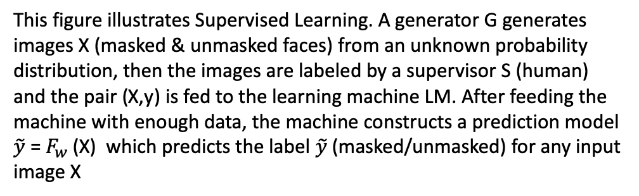
Machine Learning for image recognition
Definition: “A Machine Learning algorithm is an algorithm whose performance with respect to a task improves with data “. This term has been coined by Tom Mitchell < include classification models>
Supervised Learning
This figure illustrates Supervised Learning. A generator G generates images X (masked & unmasked faces) from an unknown probability distribution, then the images are labeled by a supervisor S (human) and the pair (X,y) is fed to the learning machine LM. After feeding the machine with enough data, the machine constructs a prediction model $\tilde{y}$ = $F_{w}$ (X) which predicts the label $\tilde{y}$ (masked/unmasked) for any input image X

Slide 5
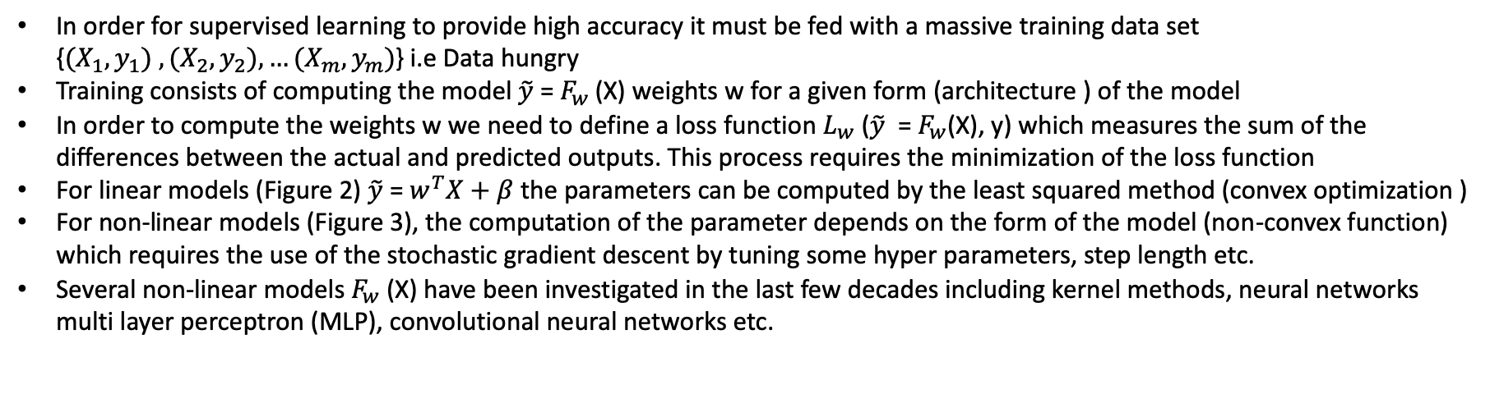
Supervised Learning
Figure 2
Figure 3
In order for supervised learning to provide high accuracy it must be fed with a massive training data set {${(X}_{1},y_{1}) ,{(X}_{2},y_{2}), …{(X}_{m},y_{m})$} i.e Data hungry
Training consists of computing the model $\tilde{y}$ = $F_{w}$ (X) weights w for a given form (architecture ) of the model
In order to compute the weights w we need to define a loss function $L_{w}$ ($\tilde{y}$ = $F_{w}$(X), y) which measures the sum of the differences between the actual and predicted outputs. This process requires the minimization of the loss function
For linear models (Figure 2) $\tilde{y}$ = $w^{T}X+β$ the parameters can be computed by the least squared method (convex optimization )
For non-linear models (Figure 3), the computation of the parameter depends on the form of the model (non-convex function) which requires the use of the stochastic gradient descent by tuning some hyper parameters, step length etc.
Several non-linear models $F_{w}$ (X) have been investigated in the last few decades including kernel methods, neural networks multi layer perceptron (MLP), convolutional neural networks etc.

Slide 6
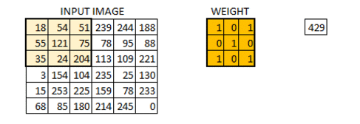
Convolutional neural networks
CNN starts with an input image RGB image captured by a camera and pre-processed by a face detection algorithm first, then mapped by a series of non-linear transformations called convolutional layers followed by max pooling transformation and the last layers are fully connected layers which gives the output value (label)

Slide 7
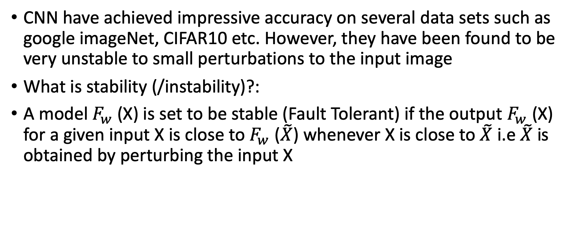
Accuracy vs Stability of CNN
CNN have achieved impressive accuracy on several data sets such as google imageNet, CIFAR10 etc. However, they have been found to be very unstable to small perturbations to the input image
What is stability (/instability)?:
A model $F_{w}$ (X) is set to be stable (Fault Tolerant) if the output $F_{w}$ (X) for a given input X is close to $F_{w}$ ($\tilde{X}$) whenever X is close to $\tilde{X}$ i.e $\tilde{X}$ is obtained by perturbing the input X
This is an illustration of the stability concept on the hyperbola F(X) = 1/X. stable on the right where X is large and instable on the left where X is near the origin
This has to do with derivative of the function, if the derivative is small then we have stability and if the derivative is large then the model is instable

Slide 8
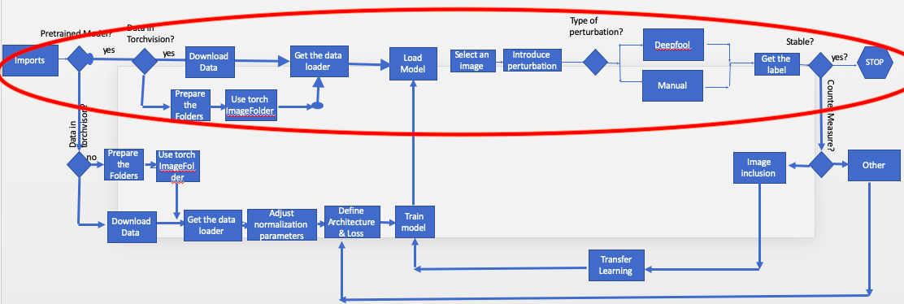
Experimental pipeline for testing stability of CNN

Slide 9
DeepFool — A simple and accurate method to fool Deep Neural Networks.
It can be easily seen using a linear binary classifier, that the robustness of the model (`f`) for an input x_{0}is equal to the distance of x_{0} to the hyperparameter plane (which separates the 2 classes).
Minimal perturbation to change the classifier’s decision corresponds to the orthogonal projection of x_{0} onto the hyperparameter plane.

